Slide 1
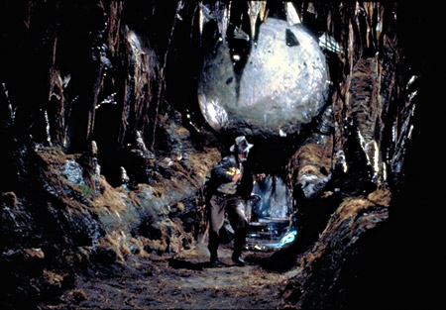
Cryptography in a
Post-Quantum World
http://indianajones.wikia.com/wiki/Raiders_of_the_Lost_Ark
Dustin Moody
National Institute of Standards and Technology (NIST)

Slide 2
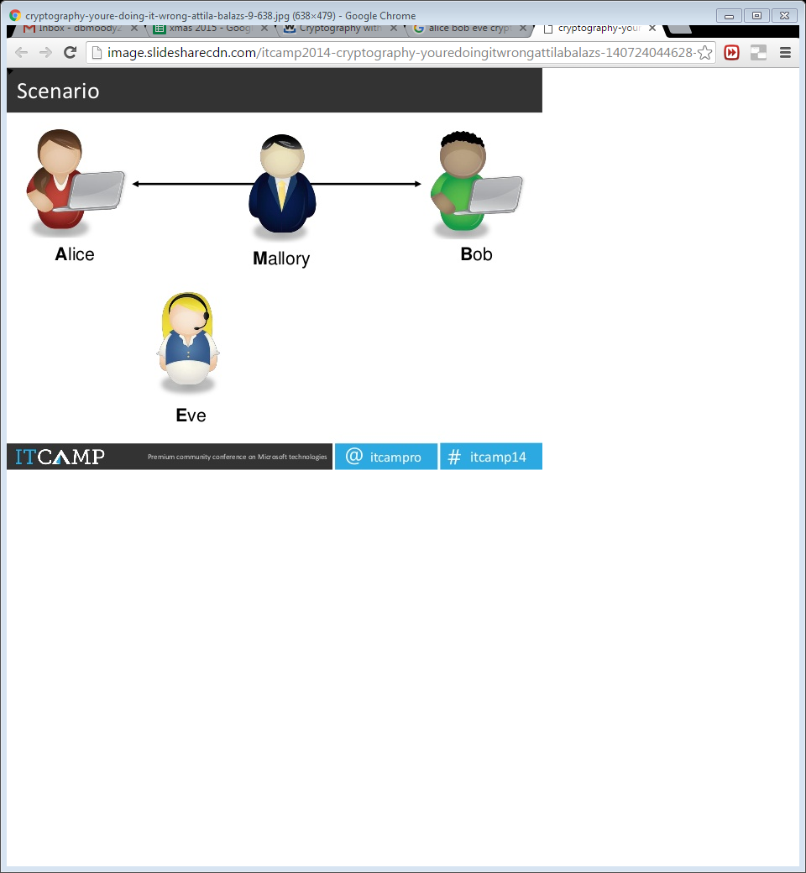
Cryptography
Alice and Bob want to communicate
  Beware of Eve
Symmetric-key crypto
  Alice and Bob have a shared key
  Example: AES (encryption)
Public-key crypto
  Alice has never met Bob, but wants to send him a message
  Example: RSA (encryption and signatures)
Notes:
How gets used: PKC is slower. Used to establish key with Bob, then switch to symmetric key.

Slide 3
Classical vs Quantum Computers
The security of crypto relies on intractability of certain problems to modern computers
  Example: RSA and factoring
Quantum computers
  Exploit quantum mechanics to process information
  Use quantum bits = “qubits” instead of 0’s and 1’s
  Superposition – ability of quantum system to be in multiples states at the same time
  Potential to vastly increase computational power beyond classical computing limit
Notes:
Quantum mechanics = behavior of small objects: atoms, electrons, photons
Superposition – allows for doing multiple computations at same time

Slide 4
Quantum Computers
Difficulties
  When a measurement is made on quantum system, superposition collapses
  Quantum states are very fragile and must be extremely well isolated
  Intersection of many developing fields: superconductors, nanotechnology, quantum electronics, etc…
1998 – 2 qubits
2000 – 4, 5, and then 7 qubits
2006 – 12 qubits
2011 – 14 qubits
Measuring qubits is not best metric
Intel’s 5-qubit processor
Notes:
Entanglement – strong correlation between two quantum particles
Claims of higher qubit computations, but not
IBM making 5-qubit cloud computer available

Slide 5
Threshold Theorem
If error per quantum computation can be brought below (roughly) 0.5%, arbitrarily long quantum computations can be performed by correcting errors as you go
Theorists improve error correction schemes to tolerate higher error rates
Experimentalists achieve lower error rates
Threshold
Theorems
Experimental
Error Rates
0.0001%
(1997)
0.5%
(2015)
5%
(1995)

Slide 6
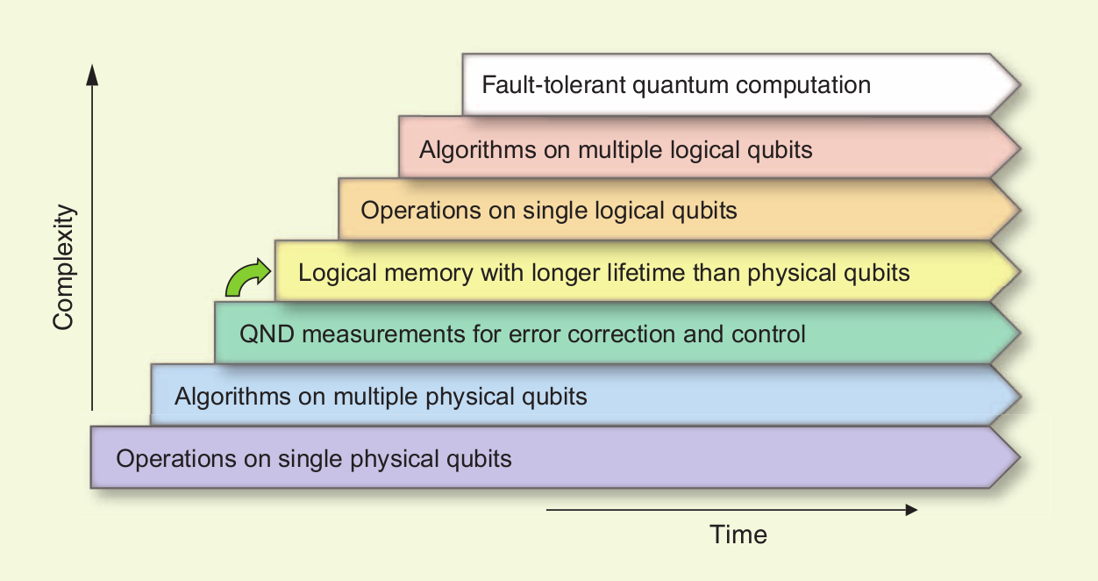
Quantum Computing Progress
A lot of progress, but still a long way to go
[Image credit: M. Devoret and R. Schoelkopf]
Notes:
QND is quantum non demolition
Chart from where?

Slide 7
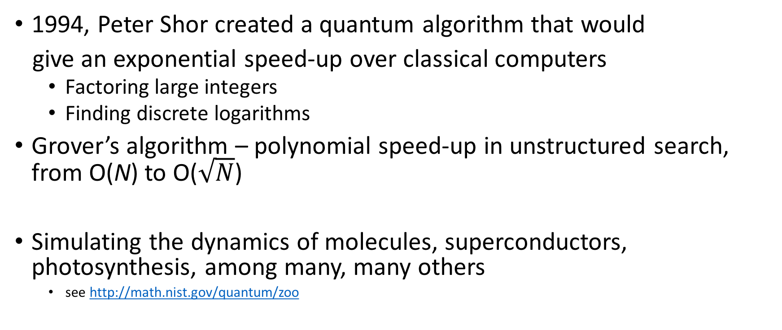
Quantum Algorithms
1994, Peter Shor created a quantum algorithm that would
give an exponential speed-up over classical computers
  Factoring large integers
  Finding discrete logarithms
Grover’s algorithm – polynomial speed-up in unstructured search, from O(N) to O($\sqrt{N}$)
Simulating the dynamics of molecules, superconductors, photosynthesis, among many, many others
  see http://math.nist.gov/quantum/zoo

Slide 8
The Sky is Falling?
If a large-scale quantum computer could be built then….
Public key crypto:
  RSA
  ECDSA (and Elliptic Curve Cryptography)
  DSA (and Finite Field Cryptography)
  Diffie-Hellman key exchange
Symmetric key crypto:
  AES
  Triple DES
Hash functions:
  SHA-2 and SHA-3

Slide 9
The Sky is Falling?
If a large-scale quantum computer could be built then….
Public key crypto:
  RSA
  ECDSA (and Elliptic Curve Cryptography)
  DSA (and Finite Field Cryptography)
  Diffie-Hellman key exchange
Symmetric key crypto:
  AES
  Triple DES
Hash functions:
  SHA-2 and SHA-3

Slide 10
The Sky is Falling?
If a large-scale quantum computer could be built then….
Public key crypto:
  RSA
  ECDSA (and Elliptic Curve Cryptography)
  DSA (and Finite Field Cryptography)
  Diffie-Hellman key exchange
Symmetric key crypto:
  AES Need longer keys
  Triple DES Need longer keys
Hash functions:
  SHA-2 and SHA-3 Use longer output

Slide 11


When will a Quantum Computer be Built?
Notes:
Glass half empty / half full
RSA 2048 – 112 bits of security
Mariantoni is professor at Inst. For Quantum Computing at Univ. of Waterloo
Michele Mosca: “1/2 chance of breaking RSA-2048 by 2031” (http://eprint.iacr.org/2015/1075)

Slide 12
When will a Quantum Computer be Built?
Quantum computers are 20 years in the future and always will be
Notes:
Glass half empty / half full
RSA 2048 – 112 bits of security
Mariantoni is professor at Inst. For Quantum Computing at Univ. of Waterloo
Michele Mosca: “1/2 chance of breaking RSA-2048 by 2031” (http://eprint.iacr.org/2015/1075)

Slide 13
When will a Quantum Computer be Built?
50% chance of breaking RSA-2048 by 2031
(Michele Mosca, 2015)
Resources needed to break RSA-2048 (Matteo Mariantoni, 2014)
    15 years
    $1 billion USD
    Small nuclear power plant
Quantum computers are 20 years in the future and always will be
Notes:
Glass half empty / half full
RSA 2048 – 112 bits of security
Mariantoni is professor at Inst. For Quantum Computing at Univ. of Waterloo
Michele Mosca: “1/2 chance of breaking RSA-2048 by 2031” (http://eprint.iacr.org/2015/1075)

Slide 14
How soon do we need to worry?
How long does your information need to be secure (x years)
How long to re-tool existing infrastructure with quantum safe solution (y years)
How long until large-scale quantum computer is built (z years)
Theorem (Mosca): If x + y > z, then worry
What do we do here??
y
x
z
secret keys revealed
time
Notes:
ECC took from it’s invention in 1985 to only now starting to be widely used in 2015. 30 years!
Even if we don’t know when (or even if it will ever happen)….it is a realistic threat so we need to prepare

Slide 15
Post-Quantum Cryptography (PQC)
Cryptosystems which run on classical computers, and are considered to be resistant to quantum attacks
PQC needs time to be ready for applications
  Efficiency
  Confidence – cryptanalysis
  Standardization
  Usability and interoperability
  (IKE, TLS, etc… use public key crypto)

Slide 16
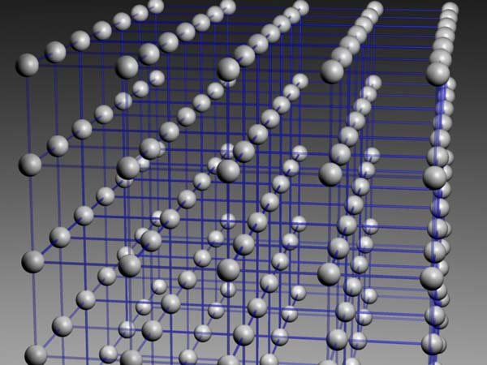

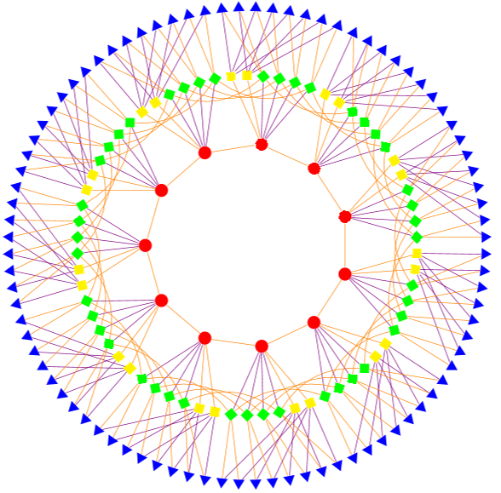
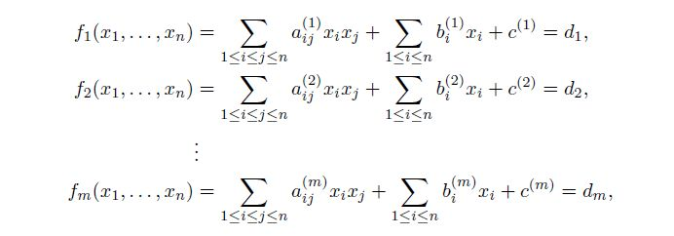
Possible Replacements
Lattice-based
Code-based
Multivariate
Others
  Hash-based signatures
  Isogeny-based signatures
  Etc….
All have their pros and cons

Slide 17
Practical Questions
Which are most important in practice?
  Public and private key sizes
  Key pair generation time
  Ciphertext size
  Encryption/Decryption speed
  Signature size
  Signature generation/verification time
Really, a lot more questions than answers
Notes:
How do you guard against a machine that hasn’t even been built yet?

Slide 18
Encryption Schemes
Algorithm | KeyGen Time (RSA sign=1) | Decrypt Time (RSA sign=1) | Encrypt Time (RSA sign=1) | Public Key Size (bits) | Private Key Size (bits) | Ciphertext Size (bits) | Time* Scaling | Key* Scaling
NTRUEncrypt | 10 | 0.1 | 0.1 | ~3000 | ~4000 | ~3000 | k² | k
McEliece | 5 | 1 | 0.02 | 651264 | 1098256 | 1660 | k² | k²
Quasi-Cyclic MDPC | 5 | 1 | 0.02 | 4801 | 9602 | 9602 | k² | k
RSA | 50 | 1 | 0.02 | 1024 | 1024 | 1024 | k⁶ | k³
DH | 0.5 | 0.5 | 0.5 | 1024 | 480 | 1024 | k⁴ | k³
ECC | 0.1 | 0.1 | 0.1 | 320 | 480 | 320 | k² | k
Disclaimer – these are rough estimates for comparison purposes only, not benchmarks. Numbers are for 80 bits of security.
* Time and key scaling ignore log k factors

Slide 19
Observations
For most of the potential PQC replacements, the times needed for encryption, decryption, signing, verification are acceptable
Some key sizes are significantly increased
  For most protocols, if the public keys do not need to be exchanged, it may not be a problem
Some ciphertext and signature sizes are not quite plausible
Key pair generation time for the encryption schemes is not bad at all
No easy “drop-in” replacements
Would be nice to have more benchmarks

Slide 20
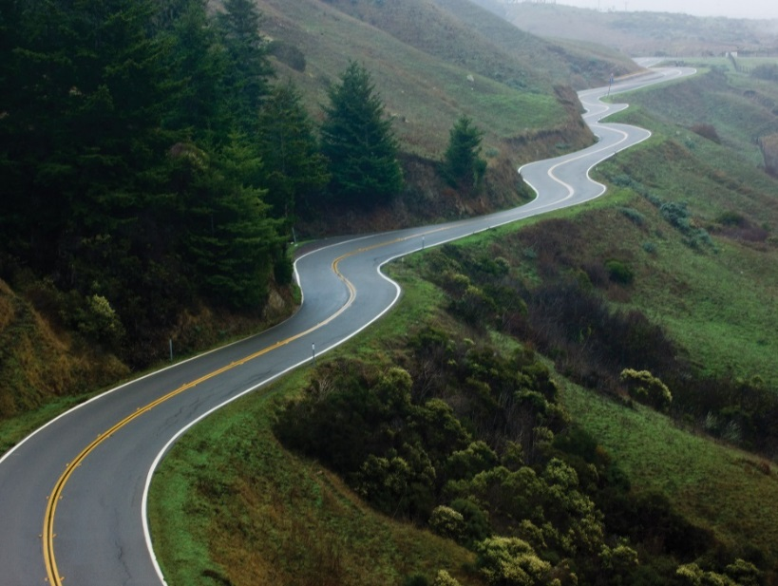
Gathering Steam
PQCrypto Workshop series
ETSI workshops, IETF (hash-based signatures)
Projects: Europe’s PQCrypto, Japan’s SAFECRYPTO
April 2015: NIST workshop on PQC
Fall 2015: The NSA announced it would be transitioning in the “not too distant” future https://www.iad.gov/iad/programs/iad-initiatives/cnsa-suite.cfm
Feb 2016: NIST report on PQC- http://csrc.nist.gov/publications/drafts/nistir-8105/nistir_8105_draft.pdf
Dec 2016: NIST Call for PQC Submissions
Notes:
This isn’t all inclusive list by any means

Slide 21
NIST’s PQC Contest Standardization Plan
Nov. 30, 2017 | Submission deadline
April 2018 | Workshop – Submitters’ presentations
3-5 years | Analysis phase - NIST reports on findings and more workshops/conferences
2 years later | Draft standards available for public comments
NIST is calling for quantum-resistant crypto algorithms for new public-key crypto standards
  Digital signatures
  Encryption/key-establishment
Selection Criteria:
  Security (classical + quantum)
  Performance
  Desired Characteristics (perfect forward secrecy, misuse resistant, simplicity,…)
Notes:
We see our role as managing a process of achieving community consensus in a transparent and timely manner
Selection criteria: Security, performance, other characteristics
Complex process

Slide 22
So What?
Quantum computers have HUGE potential for applications
Post-Quantum Cryptography should be on the radar
There will be a transition to new (public-key) algorithms in 10 years
  The transition will not be painless
  If all goes well, maybe you won’t even notice!
See www.nist.gov/pqcrypto
  PQC report and Call For Submissions are here
  Sign up for the pqc-forum for announcements and discussion
Notes:
Until then – use current recommended algorithms
Hybrid modes

